Slide 1
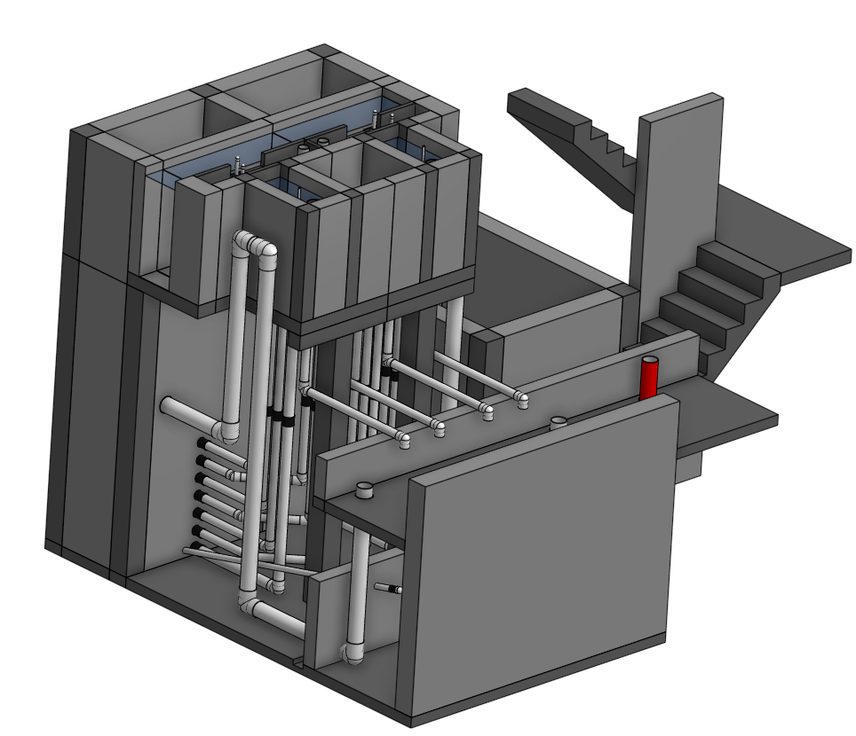
Filtration Design

Slide 2
Filtration Outline
Sand Filters
Slow sand (SSF)
Rough Gravel (RGF)
Dynamic Gravel (DGF)
Rapid (RSF)
Stacked Rapid (StaRS)
Range of applicability
Invention of StaRS

Slide 3
Categorizing Filters
Surface filtration (slow sand & membrane filters)
Particles to be removed are larger than the pore size
Clog rapidly and large piezometric head required
Head loss increases faster and faster as pores clog
Depth filtration (rapid sand and stacked rapid)
Particles to be removed are much smaller than the pore size
Require that particles collide with and attach to the media
Can handle more solids before developing excessive head loss
Head loss increases at a constant rate
Require more energy
Our focus here

Slide 4
Sand Filtration Technologies
Slow (Filters→English→Slow sand→“Biosand”)
First filters used for municipal water treatment
Were unable to treat the turbid waters of the Ohio and Mississippi Rivers
Can be used after rough gravel filters to extend range
Rapid (Mechanical→American→Rapid sand)
Used in Conventional Water Treatment Facilities
Used after flocculation and sedimentation
High flow rates→clog 12 – 90 hr→hydraulic cleaning
Stacked Rapid Sand (StaRS)
6 x smaller than rapid sand and self backwashing
No pumps needed
scrape
backwash
“Biosand” is a misnomer based on a misunderstanding of SSF mechanisms. The preferred term is intermittent SSF (ISSF)
Notes:
If you have water in a muddy river and you can only use 2 processes for treatment prior to chlorination, which processes would you choose?

Slide 5



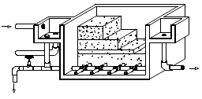
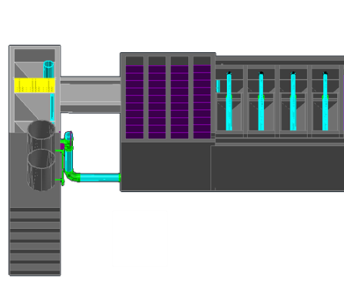
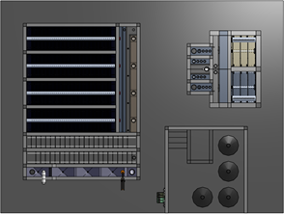
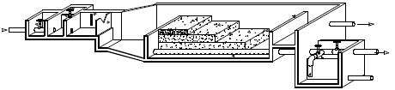
Filter range of applicability The “if it is dirty, filter it” Myth
SSF
RSF+
StaRS+
Filter performance depends on pretreatment
1
10
NTU
100
With a floc filter to extend range
1000
Notes:
https://confluence.cornell.edu/download/attachments/90755680/FiME+CINARA.pdf for info on SSF and multistage

Slide 6
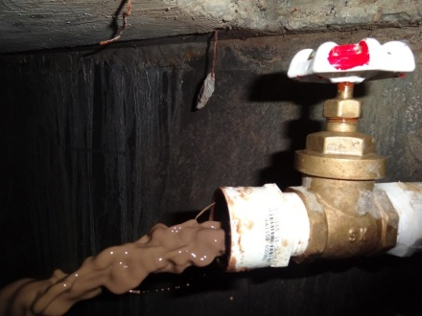
Floc/Floc Filter/Plate Settlers do the hard work
The amount of water wasted from each unit process is determined by the solids concentration of wasted water.
The goal is to minimize volume of wasted water: therefore maximize solids concentration of waste
Backwash water is less concentrated than floc hopper waste
Goal is to minimize solids entering filter!
Backwash water can be reprocessed, but that requires a pump (a good option to explore for dry season water saving)
Notes:
Estimate of backwash waste from Water Quality and Treatment: A Handbook of Community Water Supplies. 5th ed. AWWA

Slide 7
Combining Rapid Sand Filtration and pretreatment
AguaClara: Flocculation – Floc Filter – Settle – Filter
Able to treat very high turbidities because filter is the polishing step
Effluent from clarifier should be less than 2 NTU (and much lower is much better)
Conventional: Flocculate – Settle – Filter
Same as above
Direct: add Coagulant and then Filter
An option if raw water turbidity and dissolved organics are always low
less than 5 NTU

Slide 8
Slow Sand Filtration
First filters to be used on a widespread basis
Fine sand with an effective size of 0.2 mm
Low flow rates (0.03-0.12 mm/s)
Schmutzdecke (_____ ____) forms on top of the filter (surface filtration)
causes high head loss
must be removed periodically
Used without coagulation/flocculation!
Turbidity should always be less than 10 NTU with a lower average to prevent rapid clogging
Compare with sedimentation
filter cake
Notes:
See page 8.77 in Water Quality and Treatment: A Handbook of Community Water Supplies. Fifth edition.
This is the default technology that has been widely touted as the best option for the global south. However failures and abandonment are common.

Slide 9
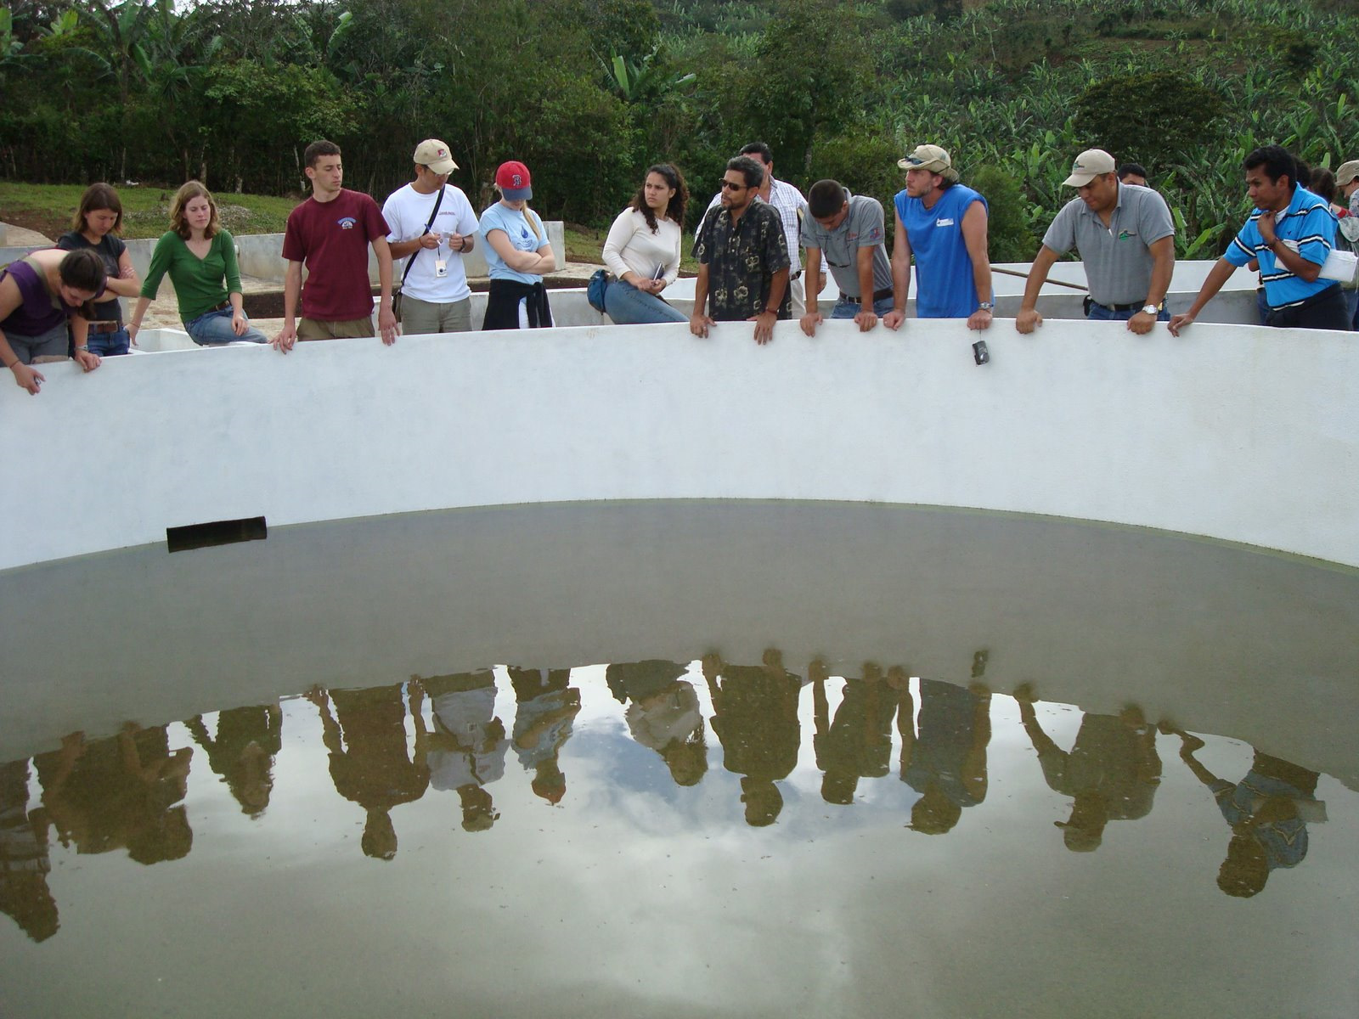
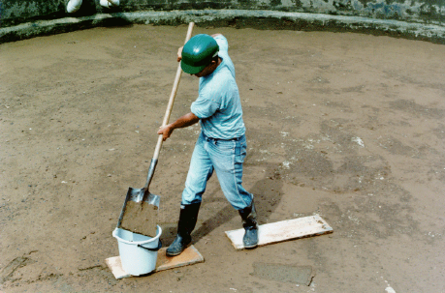
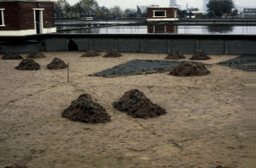
Slow Sand Filter
Notes:
Part of a multiple stage filtration plant in San Pedro de Tutule, Honduras.

Slide 10
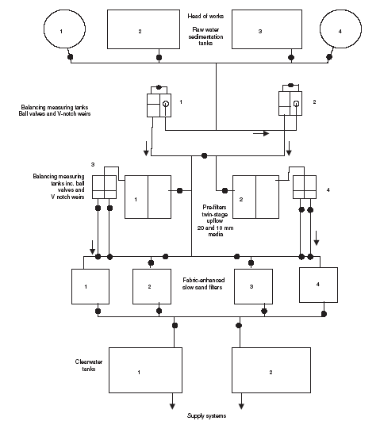
Multistage Filtration is a land and capital intensive option
Another option for communities using surface waters
Uses no coagulants (if lucky)
Gravel roughing filters
Polished with slow sand filters
Large capital costs for construction
No coagulant costs
Labor intensive operation
Notes:
http://www.atypon-link.com/TELF/doi/pdf/10.1680/wama.157.3.143.46664

Slide 11
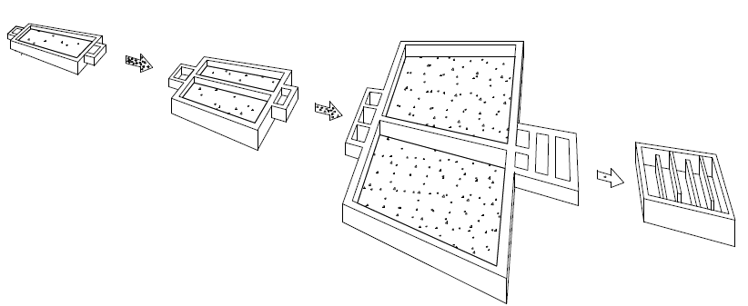
Multiple Stage Filtration
Dynamic
DGF
Rough
RGF
Slow
SSF
Disinfection
Clogs and shuts down plant during high turbidity event
Reduces turbidity so SSF doesn’t clog so fast

Slide 12
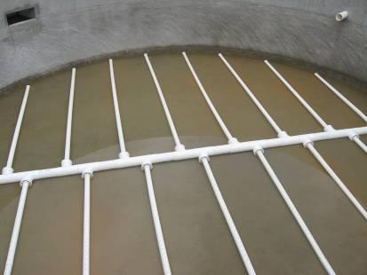
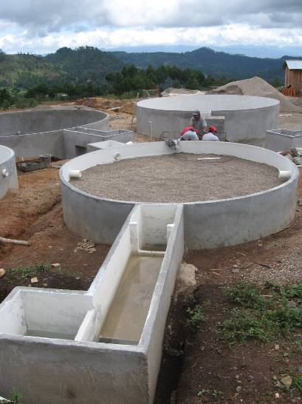
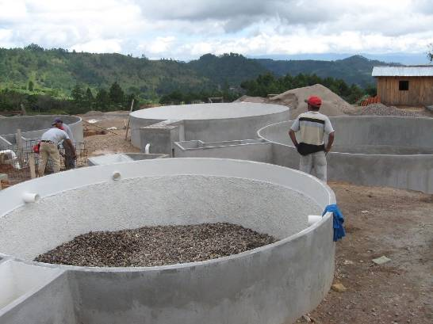
Assembling Multiple Stage Filters
Notes:
San Pedro de Tutle FIME plants

Slide 13
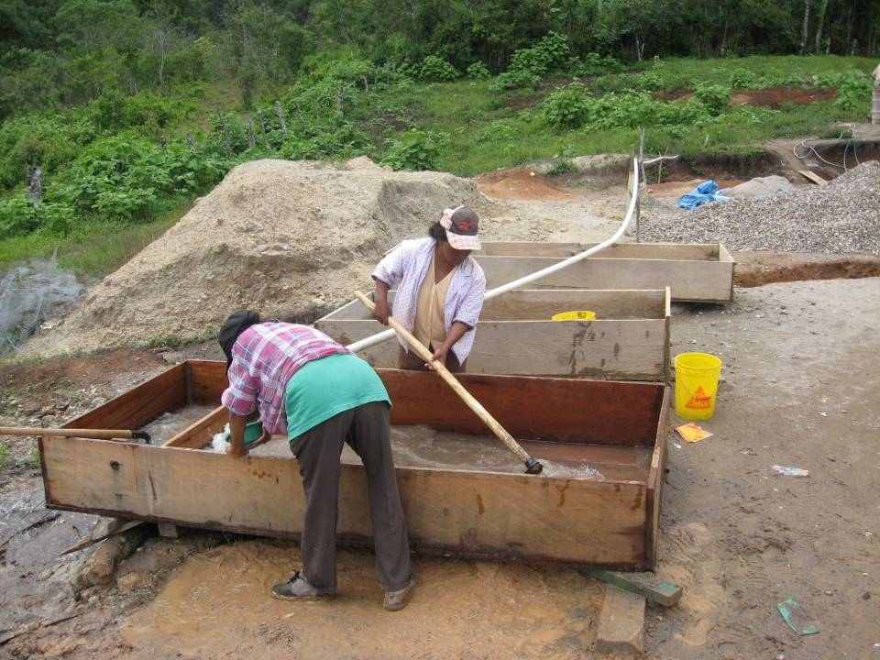
Notes:
San Pedro de Tutle FIME plants

Slide 14
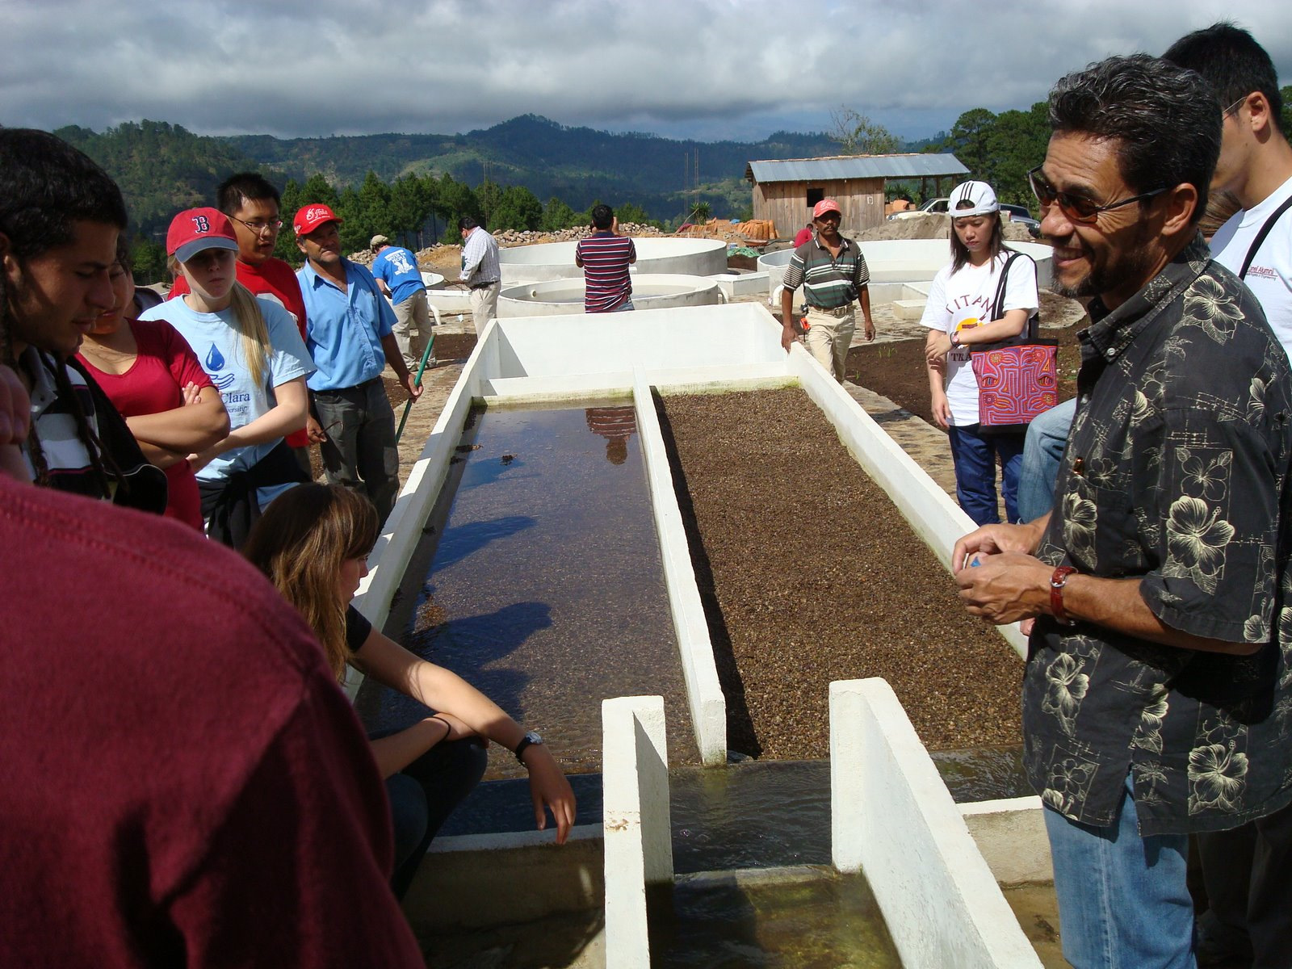
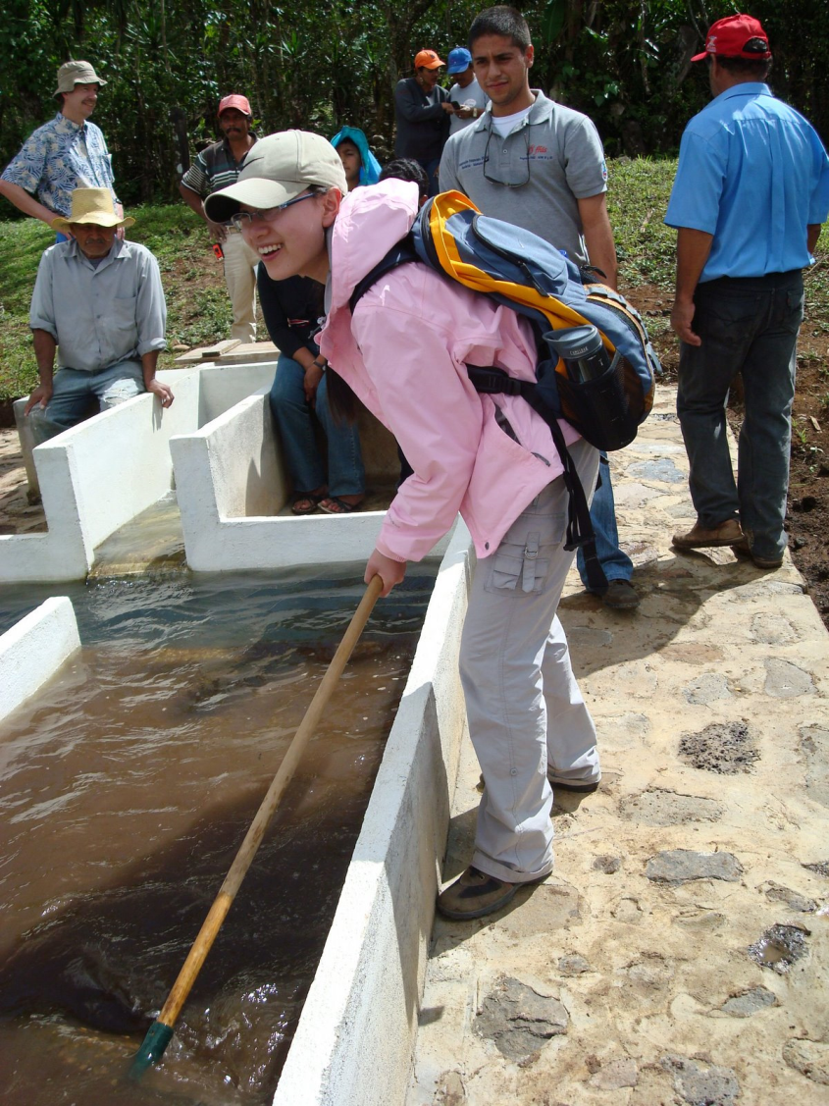
Slow Sand
Roughing
Dynamic Filter

Slide 15
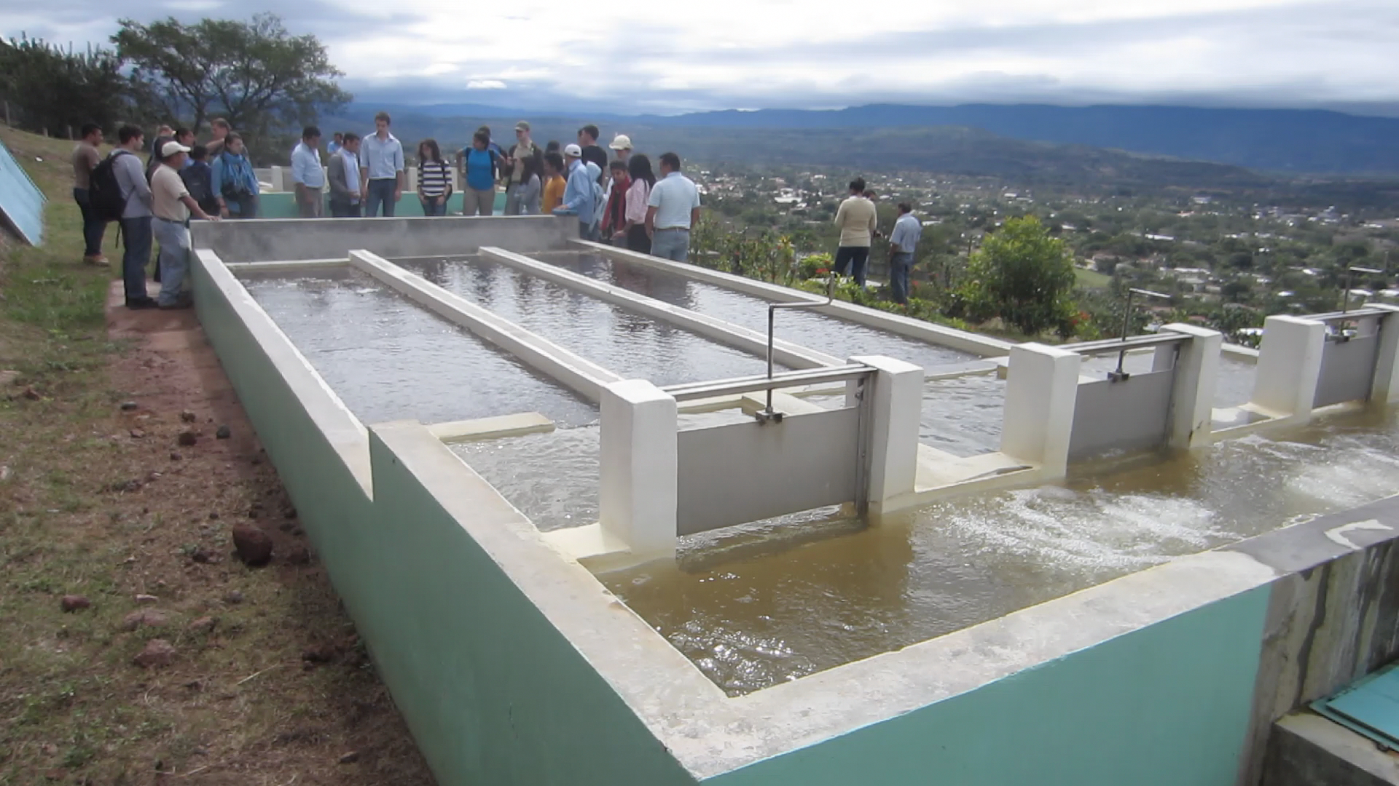
Jesus de Otoro, Honduras: Dynamic Filters

Slide 16
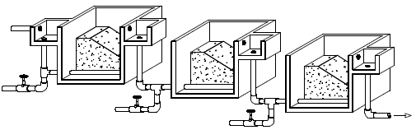
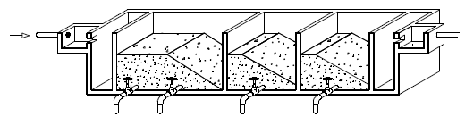
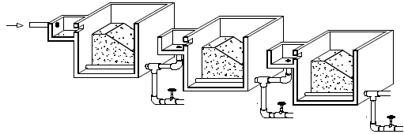
Multiple Stage Filtration Options for pretreatment for SSF
Dynamic filter (clogs to shutdown plant)
Filters in series with different size media in each filter
Up flow gravel filter with multiple layers
Best option here is dynamic + Up flow with layers
Notes:
https://confluence.cornell.edu/download/attachments/90755680/FiME+CINARA.pdf
See section 4.3 for hint that the drainage system is the piece that requires further research. This suggests that they may still be having difficulty cleaning the sediment from these filters. Note that these filters are not easily disassembled for maintenance and thus do not meet the specifications for easy maintenance required for AguaClara plants.

Slide 17
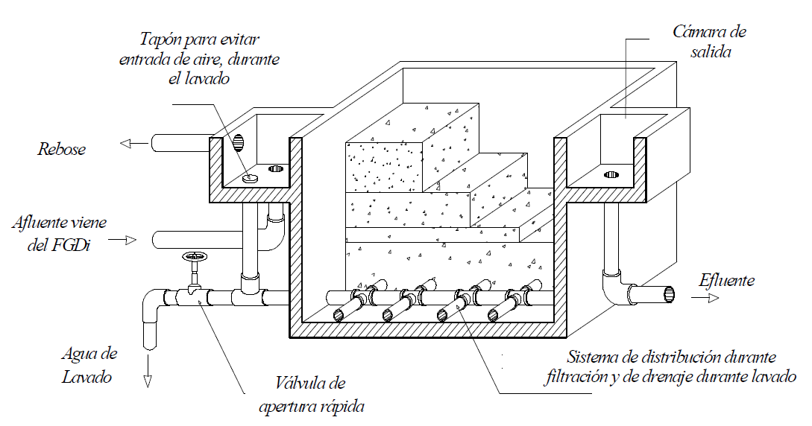
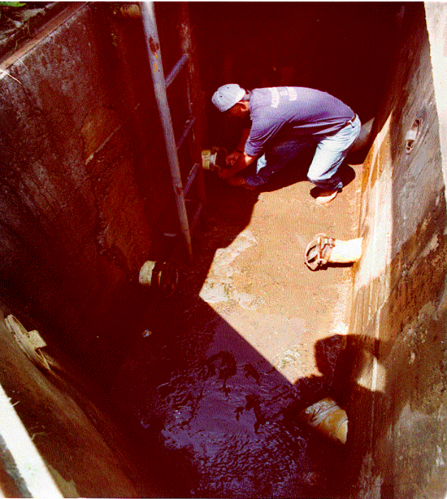
Up flow Roughing filter
0.08 to 0.17 mm/s
50x
5.5 mm/s during wash
Turbidity removal is between 50% and 90%
Exit chamber
Cap to prevent air entrance during washing
overflow
D = 1.6 – 3 mm
D = 3 - 6 mm
From dynamic filter
D = 6 - 13 mm
D = 13 - 19 mm
D = 19 - 25 mm
Effluent
2 m long
Wash water
Rapid opening wash valve
Manifold system
Cleaning, Impossible fittings, Maintenance, Water exit?
Notes:
https://confluence.cornell.edu/download/attachments/90755680/FiME+CINARA.pdf Figure 9.1

Slide 18
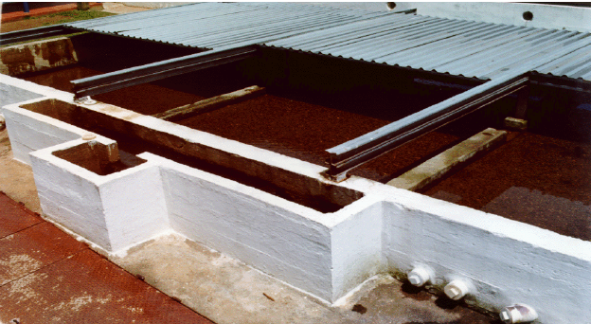
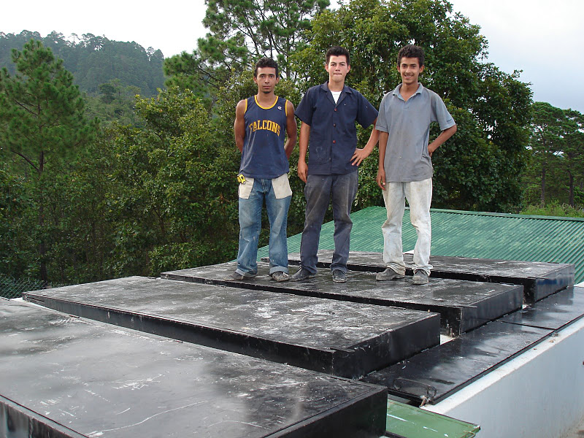
First iteration of covering a roughing filter…
Covered to reduce growth of algae. What is the next logical step?
Notes:
https://confluence.cornell.edu/download/attachments/90755680/FiME+CINARA.pdf

Slide 19
System Comparison: Multistage vs. AguaClara water treatment
Multistage has more expensive hardware (many large valves) and requires 10 to 20 times more land area
Multistage doesn’t use coagulants
Multistage performs poorly with turbid water
When might multistage be better than AguaClara?

Slide 20
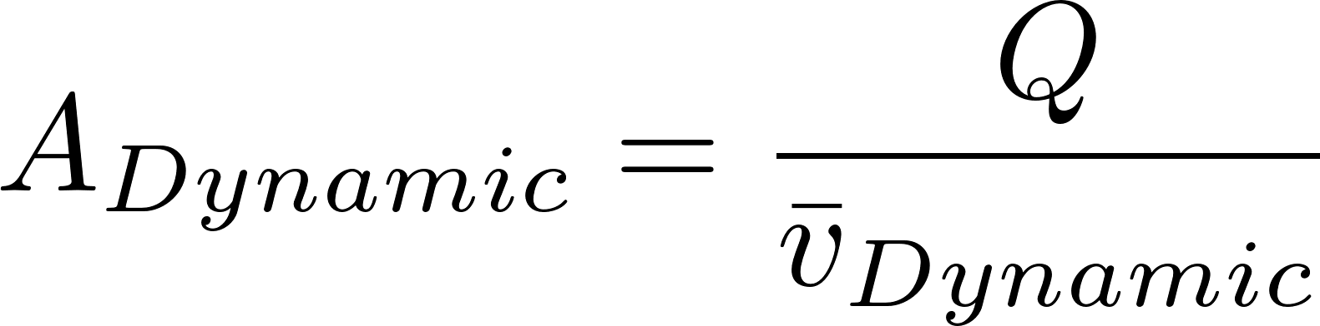
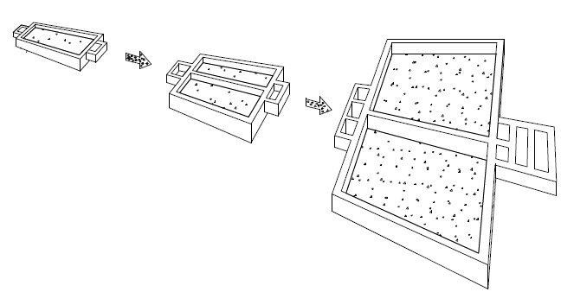

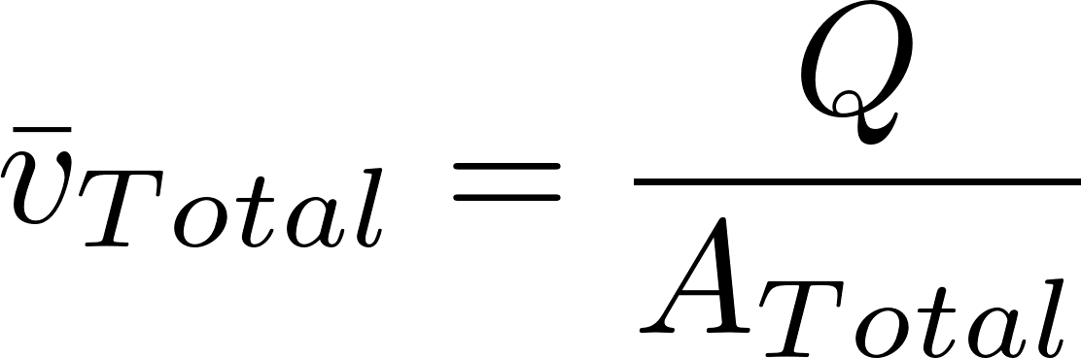
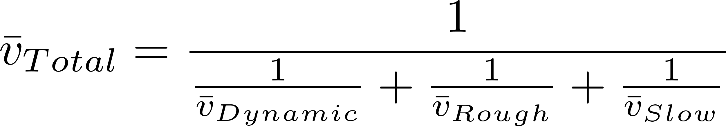
Net Velocity Concept for estimating plant size
Always check the velocity of unit processes to see if they are going to be cost effective
Use this velocity to determine approximate total unit process area.
Similar approach for sizing any facility for comparison
This term dominates

Slide 21
Filter type | Velocity (mm/s) | Cleaning | Max (NTU) | pC* | Area (m²) for 1 L/s
Dynamic | 0.4 |  |  | 0 | 2.5
Roughing¹ | 0.17 | 5.5 mm/s downflow |  | 0.5² | 5.9
Slow | 0.04 | Scrape surface | 10 | 0.8² | 25
Multistage | 0.03³ |  | 100⁴ | 1.3 | 33.4
Rapid | 0.7 – 2.8 | 11 mm/s backwash | 5⁵ | 1 | 0.55
Entrance | 8 |  |  |  | 0.125
Flocculation | 4 |  |  |  | 0.25
Floc Filter | 1 |  |  | 2.5 | 1
Floc Hopper | 5 |  |  |  | 0.2
Stacked Rapid | 1.8 x 6 | 11 mm/s backwash | 3⁶ | 1⁶ | 0.093
AguaClara | 0.6³ |  | 1000⁵ | 3.5 | 1.67
1 Roughing is up flow in layers
2 Based on table 5.7 https://confluence.cornell.edu/download/attachments/90755680/FiME+CINARA.pdf
3 Net velocity for scaling total plan view area of facility.
4 This assumes a target of 5 NTU in the effluent
5 Assumes a target of 0.3 NTU in the effluent (based on performance of the Atima plant)
6 Data from Tamara.
The 32 L/s plant at San Nicolas has 5.5 m² per L/s = 0.18 mm/s (includes chemical room, bathroom, office)
Notes:
Based on table 5.7 of https://confluence.cornell.edu/download/attachments/90755680/FiME+CINARA.pdf
Note that areas don’t include controls, entrance tanks, walkways, etc.
Flocculator is 2 m deep and residence time is about 500 s.
The 32 L/s plant at San Nicolas has 5.5 m^2 per L/s

Slide 22
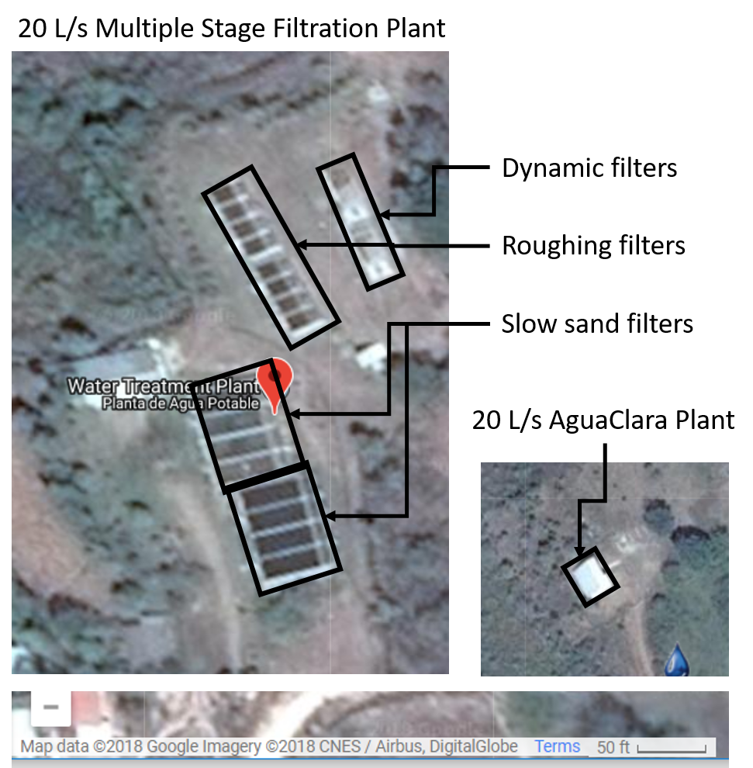
A factor of 20 matters!

Slide 23
Rapid Sand Filter (Conventional US Treatment)
Size
(mm)
0.70
0.45 - 0.55
5 - 60
Specific
Gravity
1.6
2.65
2.65
Depth
(cm)
30
45
45
Anthracite
Influent
Sand
Gravel
Drain
Effluent
Wash water

Slide 24
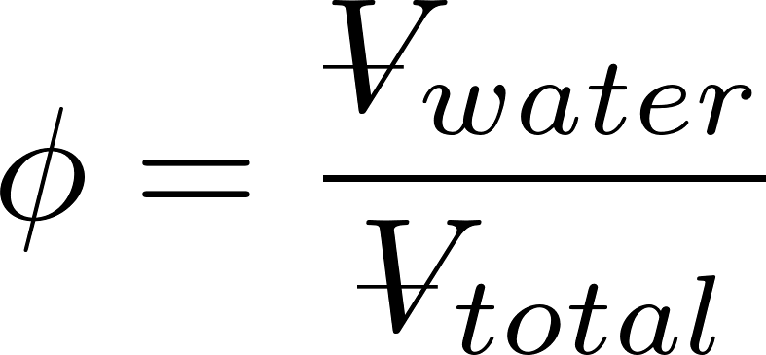
Rapid Sand Filter Design
Filter media
silica sand and anthracite coal
non-uniform media will stratify with _______ particles at the top
Filtration approach velocities
0.7 – 2.8 mm/s
Backwash approach velocities
set to obtain a bed porosity, φ, of 0.65 to 0.70
Fluidized bed
smaller
Does water speed up or slow down when it enters the sand?
Similar in size to AguaClara Clarifier (1 mm/s)

Slide 25

Backwash (Fluidized Bed)
Wash water is treated water!
WHY?
Anthracite
Sand
Only clean water should ever be on effluent side of filter!
Influent
Gravel
Drain
Effluent
Wash water
Notes:
https://www.youtube.com/watch?v=9tqk2cFDi5o#t=226
https://youtu.be/My4
<iframe width="640" height="360" src="https://www.youtube.com/embed/9tqk2cFDi5o?autoplay=1&start=226&end=240" title="YouTube video player" frameborder="0" allow="accelerometer; autoplay; clipboard-write; encrypted-media; gyroscope; picture-in-picture" allowfullscreen></iframe>RA5I0FKs?t=28

Slide 26
Fluidized Bed: each sand grain is falling at its terminal velocity
Air pressure on the bottom of the sand equals the weight per unit area of the sand!
Notes:
https://youtu.be/My4RA5I0FKs?t=28
<iframe width="1280" height="720" src="https://www.youtube.com/embed/My4RA5I0FKs?autoplay=1&start=28&end=48" title="YouTube video player" frameborder="0" allow="accelerometer; autoplay; clipboard-write; encrypted-media; gyroscope; picture-in-picture" allowfullscreen></iframe>
Example code
<iframe width="791" height="445" src="https://www.youtube.com/embed/oHcKJD_OdfI?autoplay=1&start=285&end=360" title="YouTube video player" frameborder="0" allow="accelerometer; autoplay; clipboard-write; encrypted-media; gyroscope; picture-in-picture" allowfullscreen></iframe>

Slide 27
Filter Hydraulics
Porosity
Sand size definitions
Clean bed head loss estimates
Backwash requirements
Low flow design challenges: the backwash dilemma

Slide 28
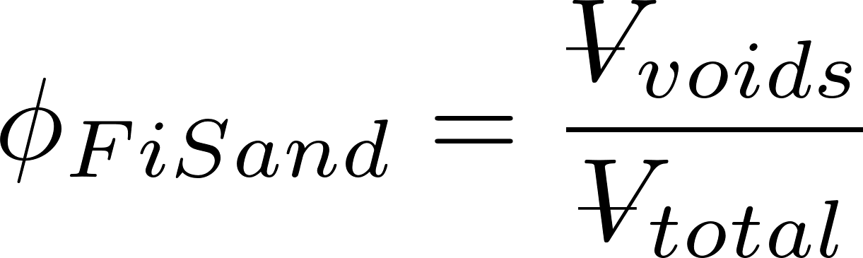
Porosity
volume of voids
total volume
Example: 1 m³ of dry aquifer material weighed 1600 kg. The aquifer material was then saturated with water and found to weigh 2000 kg.
What is the porosity of the aquifer material?
What is the bulk density of the aquifer material?
What is the density of the aquifer material?
0.4
1600 kg/m³
2700 kg/m³ [1600 kg/(0.6 m³)]

Slide 29
Porosity
Which will have the greatest porosity?
1 µm diameter clay
0.2 mm diameter sand
1 cm diameter gravel
You have been given 100 kg each of clay, sand and gravel
What could you do to create the lowest porosity?
100 kg gravel, 100*0.4/0.6 kg sand, 100*(0.4/0.6)² kg clay
Notes:
100 kg, 67 kg, 44 kg

Slide 30
Sand Grading
Effective Size
D₁₀ - sieve size that 10% by mass of the sand passes through
Used for filter particle removal modeling
D₆₀ – sieve size that 60% by mass of the sand passes through
Used for hydraulic modeling
Uniformity Coefficient = D₆₀/D₁₀

Slide 31
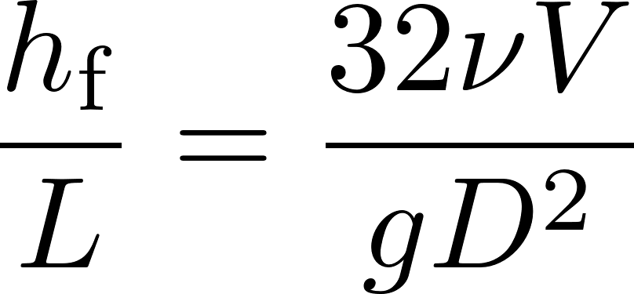
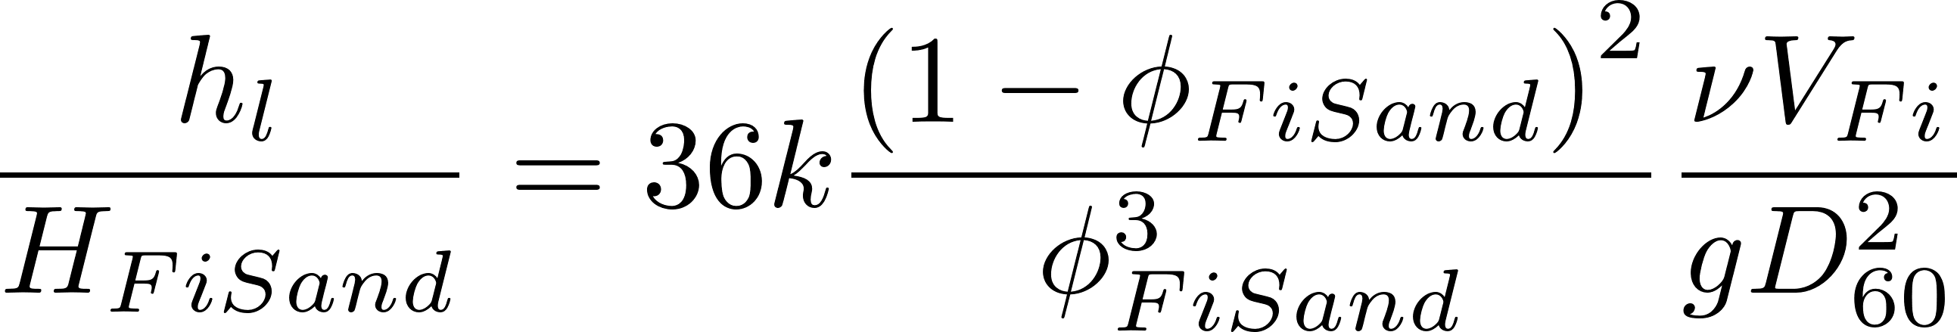
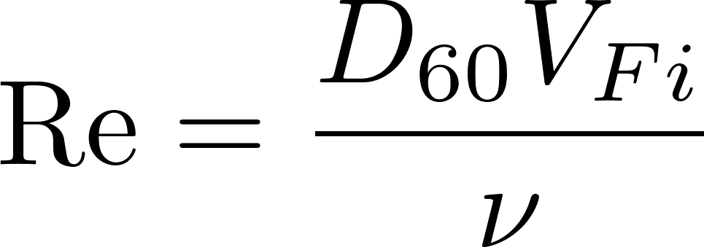
Clean Bed Head Loss (Karmen Kozeny)
Hagen Poiseuille
Porosity (0.4 for uniform size media)
Kinematic viscosity
Approach velocity
Head loss
Sand diameter
Flow path length (filter bed depth)
Kozeny constant
Approximately 5 for most filtration conditions
Assumes laminar flow and is valid up to Re of 6
Notes:
Karmen Kozeny valid up to Re of 6
Page 8.10 in Water Quality and Treatment: A Handbook of Community Water Supplies. Fifth edition.
What happens if we have an upflow RSF and we gradually increase the filtration velocity? At some point (to be determined) the pressure difference will be enough to lift the entire sand bed!

Slide 32
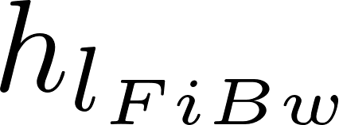
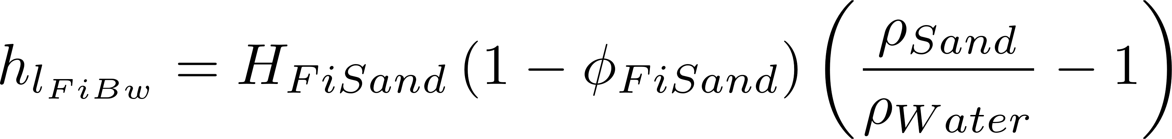



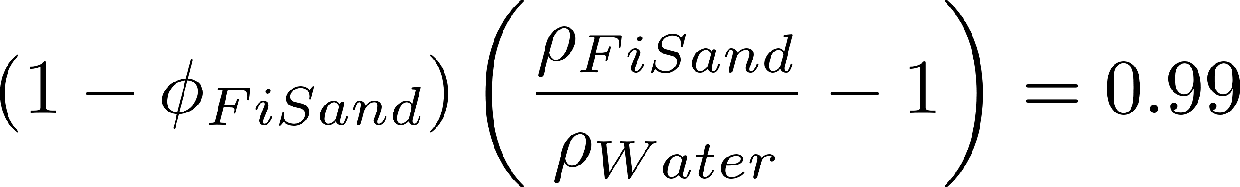
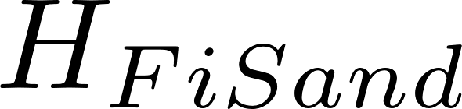
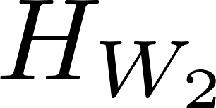
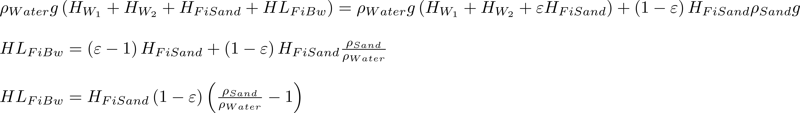
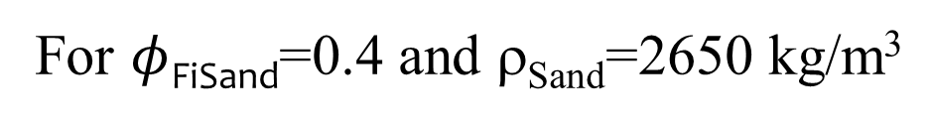
Backwash Requirements – Head Loss (force balance)
Weight of water/Filter area
Weight of sand/Filter area
=
For $φ$_{FiSand}=0.4 and ρ_{Sand}=2650 kg/m³
Notes:
The pressure drop times the filter area is equal to the buoyant weight of the sand grains.
Density of sand + water (not yet expanded) is 2 * water density

Slide 33
What does this analysis miss?
Sand bed may first lift as a unit and then fall into the fluidized state
Wall shear (scale effect!!!!) and embedded pipes may prevent bed lift (or require more force than our simple force analysis suggests)
Sand will stratify if there is even a small range of sizes: Backwash velocity must be sufficient to fluidized the largest sand
Backwash initiation requires more study
Notes:
Also! Dirty sand has more head loss!

Slide 34
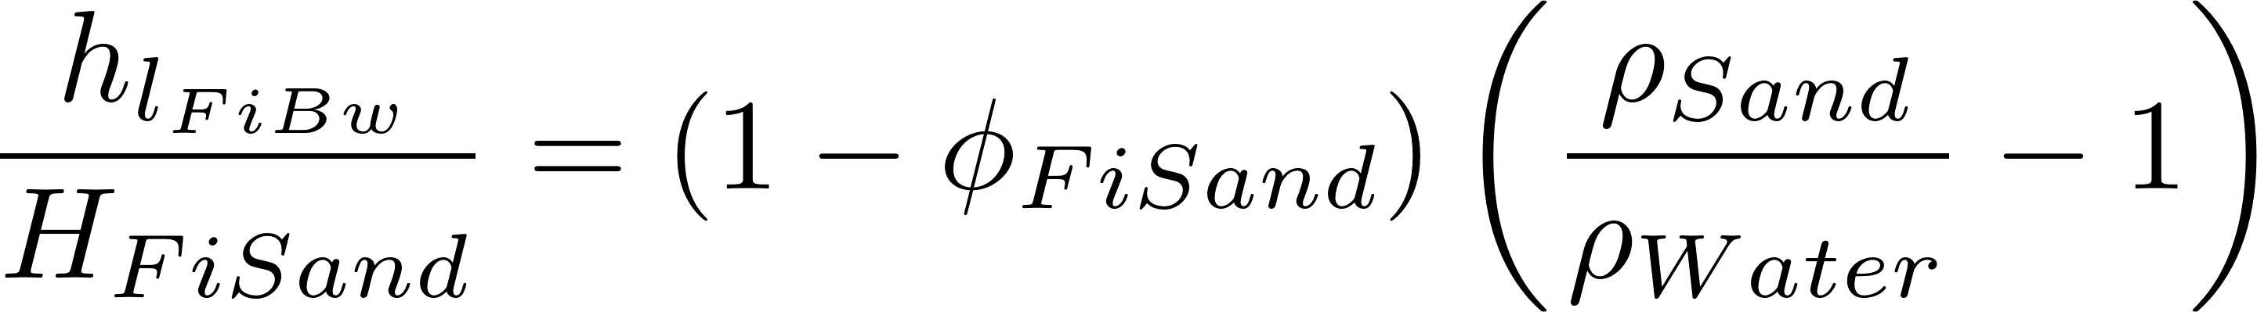
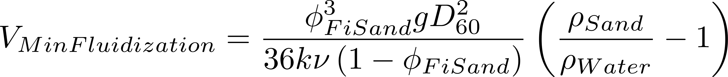
Backwash Requirements – Flow Rate
Kozeny
Backwash Head Loss (force balance)
Set them equal
Minimum approach velocity required to fluidize bed
Notes:
Using D60 might not be conservative enough.

Slide 35
Head loss through a filter as a function of flow rate
Depth of sand
Fluidized bed
Constant head loss!
Force balance always applies
Head loss
5
10
Upflow velocity (mm/s)
Notes:
What would happen if we tried this in a water filtration plant (AguaClara or otherwise)?
Eventually head loss would drop! Because sand would wash out!

Slide 36
Backwash sand bed stratification
Suppose the sand stratifies in the filter bed during backwash and suppose that 10% of the bed is smaller than 0.4 mm and 10% of the sand is bigger than 0.8 mm
What is the ratio of fluidization velocity for the top of the sand bed to the fluidization velocity for the bottom of the sand bed?
Notes:
Sand at top has a diameter that is ½ of the sand at the bottom. Therefore velocity to fluidize the top will be ¼ of the velocity required to fluidize the bottom. Thus seeing sand fluidize at the top of a filter bed does not guarantee that it is fluidized at the bottom.

Slide 37
First identify a need, then invent
Slow sand – capital and labor intensive
Rapid sand – require pumps for backwash
Neither of these are good options for small communities
Has anyone invented any alternatives? Yes! CEPIS
Invent time!

Slide 38
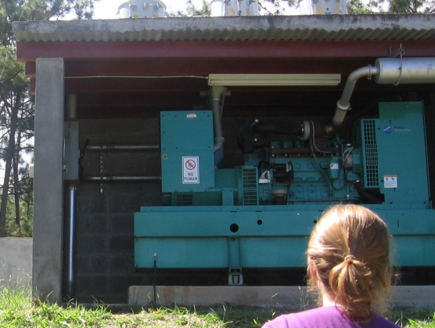
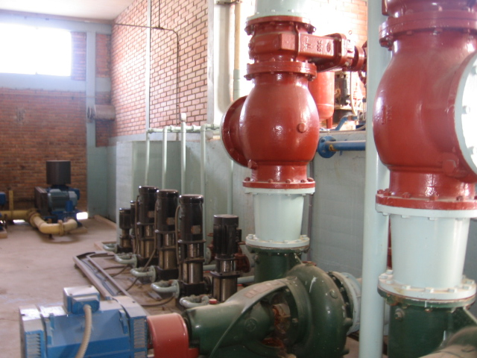
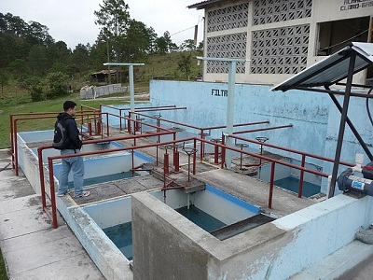
The Backwash Dilemma
Backwash velocity >> filtration velocity
Backwash water must be clean water
Backwash water sources?
Pump it from clearwell
Set of filters working in parallel to backwash one filter
Filtered water stored at adequate elevation

Slide 39
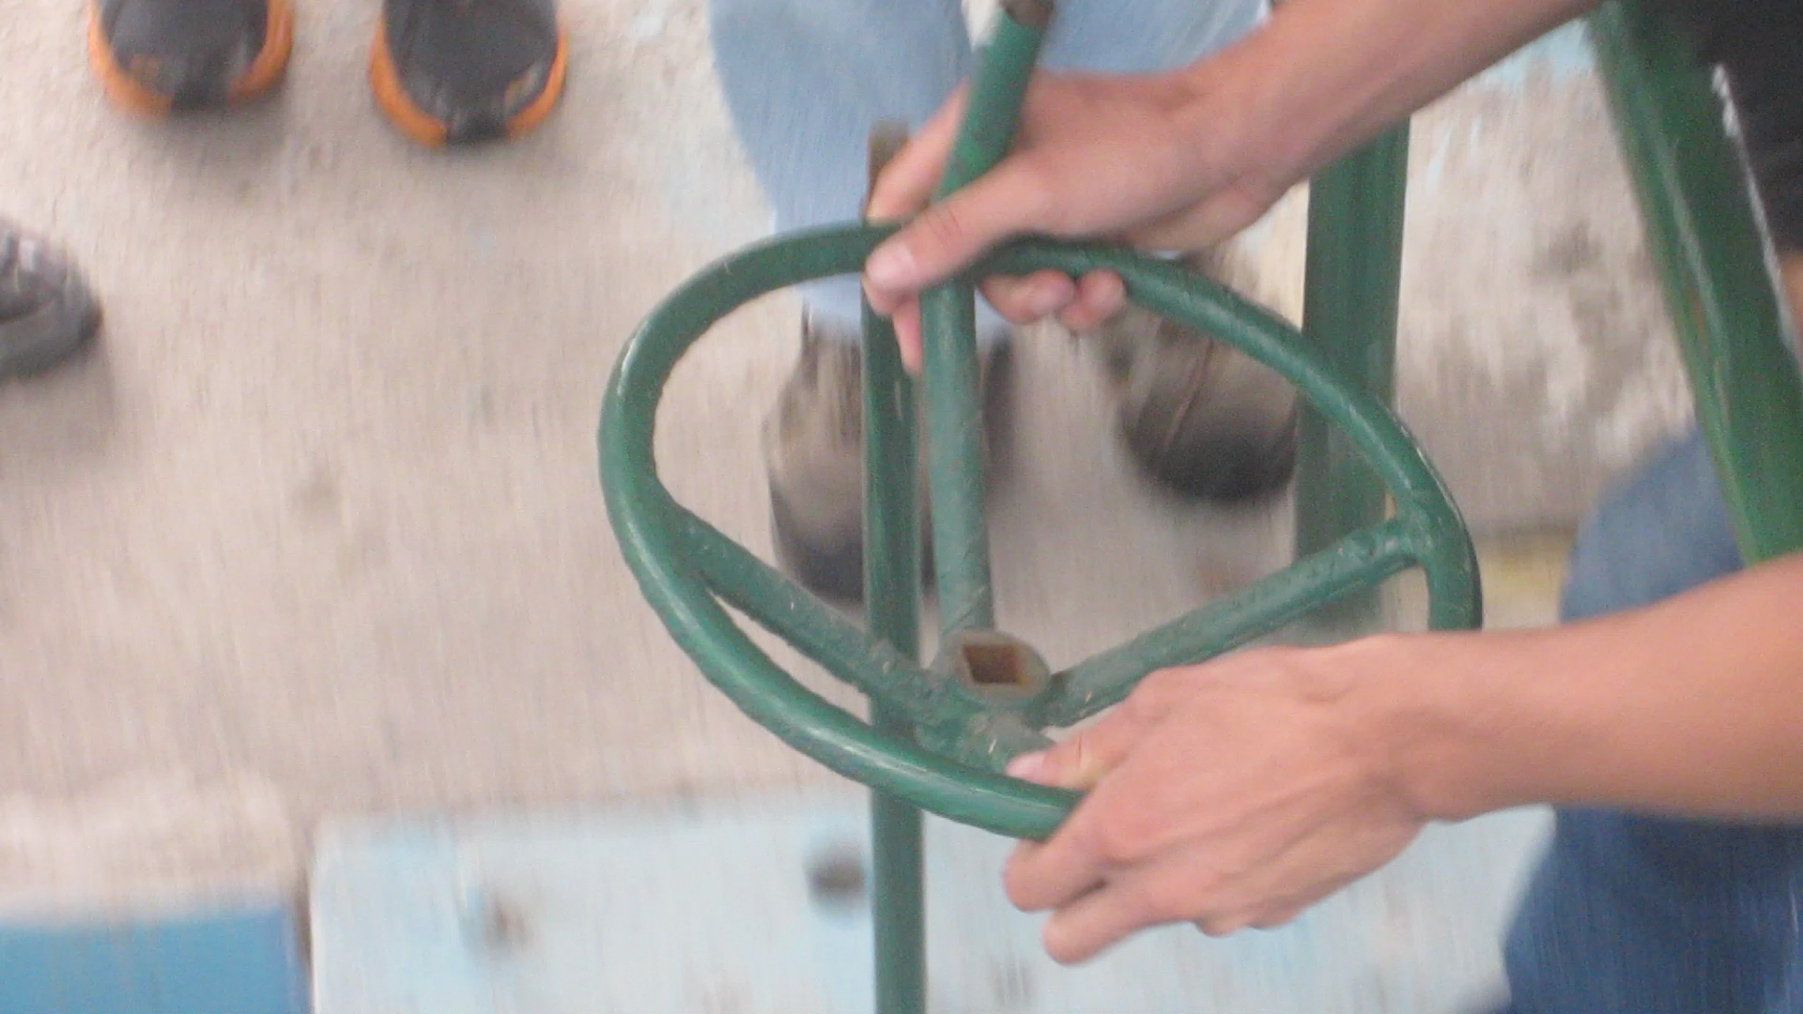
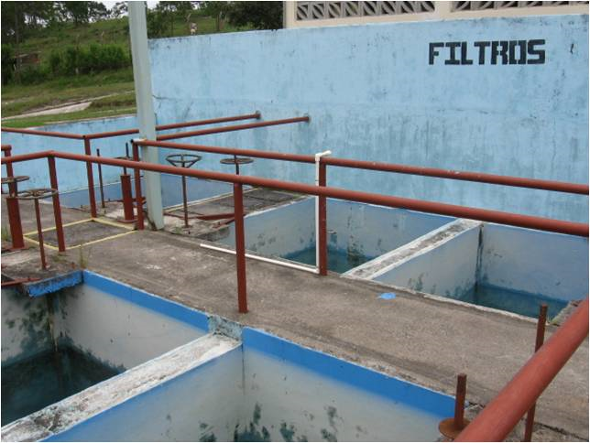
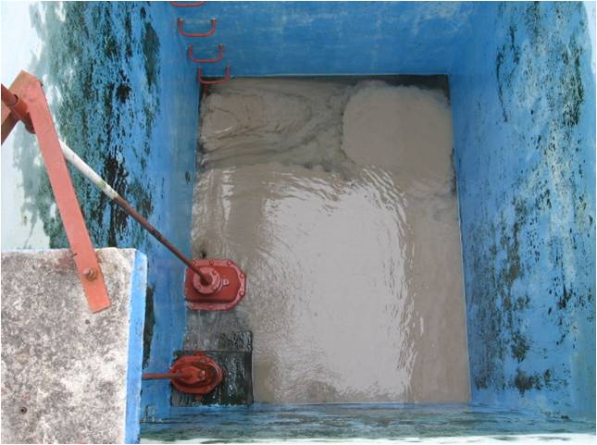

Rapid Sand Filter Set: Backwash without pumps
What are these two valves controlling? Reverse engineer the universe!
https://confluence.cornell.edu/display/AGUACLARA/Santa+Rosa+de+Copan

Slide 40


The Low Flow Challenge: Filter Set
Assume plant flow is 6 L/s, Filtration velocity is 1.8 mm/s and backwash velocity is 9 mm/s and that a set of filters will backwash one filter
How many filters?
Total filter area?
What happens if the plant is operating at half capacity (drought conditions)?
Need filters to be smaller to be able to backwash one!

Slide 41

Store filter water?
Try two filters and recalculate
Require a large tank and the tank must be shallow to keep filters from being really deep.
Filters need to be able to load the tank during filtration and then take water from the tank during backwash. This is accomplished by having the filter water level VERY high during filtration and low during backwash
Would increase AguaClara plant size by 50%! Vnet for entire plant is 0.18 mm/s
Notes:
Fails the ridiculous test as named by Mickey Adelman
Identify filtration head loss and backwash head loss

Slide 42
The Low Flow Challenge
Requiring 6 (or 12) filter boxes for a small plant is too costly and difficult to construct and maintain.
Storing filtered water requires a storage tank with a Vup less than the entire AguaClara plant!!! (the tank is bigger than the plant!)
If we rule out the pump option, then we have no good options…

Slide 43
Why is this difficult?
The backwash dilemma is due to the big difference between backwash flow rates and filtration flow rates
6 filters are required if backwash velocity is 5 times the filtration velocity
If we could get those velocities to be similar or equal, then we wouldn’t need a set of 6 filters
Invention time
Notes:
Brainstorm ways to get those velocities to be similar!
Decrease media density so it fluidizes at a lower velocity
Decrease media diameter so it fluidizes at a lower velocity (but that will increase head loss during filtration mode too)
Make a more compact filter. (filter in parallel, backwash in series!)

Slide 44



Geometric Trick: Stacked Rapid Sand Filter (StaRS)
Instead of 6 filters side by side, stack them up!
Reduce backwash water volume by factor of number of layers
Notes:
Optimal number of layers is a function of backwash requirements and optimal filtration velocity. We are using shallower filter beds than conventionally used and thus filter performance is expected to be poorer.

Slide 45
Water Source for Backwash
Tradition says Filtered Water
Why not use Clarified water?
Public Health trade off?
Filter to waste after backwash is required in any case due to contamination of manifold tubing
Use of clarified water significantly simplifies the system
Same flow rate and water source during filtration and backwash!!!!
Eliminate empty clearwell failure mode

Slide 46

Stacked Rapid Sand Filter in Context
Trace the flow of water through the plant

Slide 47

Backwash recycle tank
Channel from clarifiers
Remove red pipe to enable backwash recycle
Backwash siphon
Sand dump

Slide 48

Top View of Filter Controls
Removable gate to set backwash flow to design flow rate
Broad weir to divide flow between filters
Filter emergency bypass
Channel with clarified water
Slot weir can be shut off to take filter out of service
Clarified water
Backwash siphon pipe (missing air control valve)
Orifice to add head loss to backwash trunk during filtration
Filtered water
Overflow indicating end of filter run
Weir to enable filter to waste

Slide 49


Overflow when head loss thru filter is too large (signals end of filter run)
From Clarifier
Inlet tank: Clarified water
Plant waste channel
Sand Dump Channel

Slide 50

Inlet tank water level (maximum level signaling end of filter run)
Filter water level
Siphon pipe and sand dump pipes removed to show inlet and outlet pipes

Slide 51

Inlet tank water level is below the top of the pipe stubs for all except the backwash inlet
Backwash water level
Siphon pipe and sand dump pipes removed to show inlet and outlet pipes

Slide 52

Sand dump
Sand dump removes fluidized sand from the bottom of the filter
Sand dump pipe exits in the sand channel

Slide 53

Filtration mode
Backwash mode
Overflow indicating maximum filter head loss
Ready for filter to waste
Orifice for flow distribution in filter mode
Slot weir
Slot weir limits flow in backwash
Wide weir
Backwash gate in filter mode
Backwash gate removed if needed to achieve target flow for backwash mode

Slide 54

Remove to filter to waste
Outlet tank
Filtered water

Slide 55

Backwash siphon
Backwash discharge into drain channel

Slide 56

StaRS Internal Plumbing
Doesn’t show inlet branch “wings”, CAD update pending
Missing cable that will hold this all to the concrete slab
Hose clamp that holds receptors tight on branches

Slide 57


StaRS Internal Plumbing
Receptor
View rotated 45°
Branch
Top inlet
Band clamp
Middle inlets
Outlets
Backwash inlet
Receptor
Trunk
Notes:
Notice that the inlets have different numbers of orifices.
We get equal flow during filtration by adding head loss to the backwash inlet with an orifice.

Slide 58


Inlet Branches
Trunk end
Receptor end curved mold to prevent rotation
wing
View from below

Slide 59

Inlet Branch in the sand
During backwash there is no flow up into the wing
Horizontal interface between fluidized bed of sand and the interior of the wing
Wing prevents any sand from entering the branch
Wing also allows flow distribution!

Slide 60

Outlet Branches: 0.2 mm slots to prevent sand from exiting
0.2 mm slots
Trunk end
Curved mold that
fits to the receptor pipe and prevents the branch from rotating

Slide 61
Slotted Outlet Branch Failures
Problem
Branch bends at the beginning of backwash when sand is pushing up on it
Slots open up when the branch bends
Sand gets wedged into the slots
Solution
Upgrade from 1” ND pipe to 1.5” ND pipe to reduce bending
This allows using the same size branch for all inlets and outlets including backwash winged branches

Slide 62


StaRS Filter Fabrication
San Matías construction

Slide 63


Pipe Gallery (San Nicolas)

Slide 64
Eliminating 7 big valves: One valve control of a StaRS Filter
The following slides illustrate the method of using a siphon tube to initiate backwash
The filter animation only shows how the siphon will work. It doesn’t show how the inlet and outlet manifolds will be controlled
The Filter Inlet and Outlet control boxes will be designed so that water level changes* during backwash will cause all of the manifold pipes to be hydraulically separated and thus no valves will be required to turn off the inlet or outlet pipes
Notes:
*This will require a slight increase in the depth of the filter to accommodate a larger change in water levels between filtration and backwash

Slide 65
Begin Filtration

Slide 66

Begin Backwash
Notes:
Need to analyze the beginning of the siphon right after the air pressure is equalized with atmospheric pressure. It appears that we may need the height of water above the top of the siphon tube to equal the depth of submergence of the end of the siphon to initiate flow through the siphon

Slide 67
End Backwash

Slide 68

The big flush
Patent US2017263 - FLUSHING APPARATUS - Google Patents
Notes:
Patent US2017263 - FLUSHING APPARATUS - Google Patents

Slide 69

End Backwash cycle
What is the head loss through the sand bed + plumbing?
Constraints on depth of water in inlet box during backwash?
What is the head loss in the sand bed between an inlet and an outlet?
Notes:
Backwash water level must be high enough to not pull air into the filter and low enough to not flow into the other inlets.

Slide 70




Head loss between trunks Assume expansion ratio of 1.3
Find depth of settled sand in 20 cm of expanded sand
Settled depth
Expanded depth (20 cm)
Filter expansion ratio
This is head loss per 20 cm of expanded bed!

Slide 71
Head loss through FIXED HEIGHT of the Fluidized Bed as a function of flow rate
Not sure about shape of this part of the curve
1
Head loss
ΔH
5
10
Upflow velocity (mm/s)
Sand terminal velocity
Notes:
This is how we could tell if sand is fluidized

Slide 72


Begin Filtration cycle
Inlet pipe head loss
Outlet box
Total filter head loss

Slide 73
End Filtration cycle
Outlet box
Total filter head loss
What causes water to flow through the filter bed?
____________________________
differences in piezometric head
Notes:
Does gravity matter?
Apply the energy equation.
What must be true about the head loss for each parallel path?
What is the ratio of flows that the bottom inlet must be able to handle? If the head loss in the bottom inlet system is 10 cm during filtration, then what would it be during backwash?
What does this say about the head loss in the inlet system during filtration?
What must be true about the head loss in the pipe inlets in order to get uniform flow distribution?

Slide 74
Backwash cycle

Slide 75


Slide 76


Slide 77
How does water flow through StaRS Filters?
Water flows in direction of decreasing piezometric head

Slide 78
Filter Design Constraints
Horizontal spacing between inlet pipes (or outlet pipes) must be small compared with layer depth
All inlets and outlets (except bottom inlet) must be high and dry during backwash
Achieving uniform flow distribution between filter layers and within a filter layer requires careful design (manifolds coming up!)
Notes:
See manifold notes for justification for kinetic energy guide.

Slide 79




Inlet
Outlet
Max and min filtration water levels
10 cm
10 cm
10 cm
Pipe OD
Notes:
This doesn’t have every last detail included (such as head loss over the backwash weir, but it is close.
How could you measure expansion ratio?

Slide 80
StaRS Backwash Advantages
Where does the water come from that fills the filter box at the end of backwash?
Where does the water come from that slowly fills up the filter box during a filtration run?
Unlike RSF the backwash water above the StaRS bed does not pass through the sand during filtration
No danger of running out of water for backwash unless lack of water coming to plant
Notes:
All the inlets with most coming from top inlet
Top inlet

Slide 81


EStaRS and OStaRS Enclosed vs. Open
Fabrication becomes difficult with filter dimensions less than 1 m x 1m
Minimum OStaRS flow rate is about 10 L/s
EStaRS doesn’t require excavation because filter is operated under vacuum for backwash

Slide 82



Enclosed StaRS
Inlet Tank
Clarified water
Outlet Tank
Filtered water
Backwash Valve
Inlet Tank
Backwash round weir

Slide 83
EStarS Backwash
What happens when we close the backwash valve at the end of backwash?
What happens when we try to start the next backwash?
Solutions?
Move valve to very end of pipe (still run risk of air filling vertical section of pipe)
Add water seal
Water seal that prevents air from displacing water in backwash pipe
Notes:
Water drains out of vertical section of pipe
Can’t get enough flow to flush air out of vertical section of pipe and thus can’t generate enough pressure difference across the sand to suspend it.

Slide 84
EStaRS Pressure at end of filtration
Water level at inlet
Total potential energy available to push water through sand (and floc filters)
What happens if I drill a hole in the top of the filter during filtration?
Does water come out?
Does air flow in?
Water level at outlet
Notes:
Density of sand + water (not yet expanded) is 2 * water density

Slide 85
EStaRS Pressure during Backwash
What happens if I drill a hole in the top of the filter during backwash?
Does water come out?
Does air flow in?
Water level at inlet
Total potential energy available to suspend sand and for head loss in pipes
Water level at outlet
Notes:
Density of sand + water (not yet expanded) is 2 * water density

Slide 86


EStaRS Controls
Inlet weir that divides flow between parallel EStaRS
(remove coupling to increase flow during backwash)
LFOM (that flows from inside to outside) to measure flow to each EStaRS (same function as slot weir in OStaRS)
Clarified water
Bottom (backwash) inlet
Filter to waste
Filtered water

Slide 87
EStaRS Advantage
Can be built in a factory
Easy to add an extra filter to expand capacity
Doesn’t waste as much water during backwash! (no big flush needed to change the pressure and initiate backwash)
EStaRS is still in the design process as we develop fabrication methods

Slide 88

StaRS Challenges
Inlet slotted pipes clog
2015 replaced with wing
Could we replace outlet slotted pipes?
Gravity Exclusion Zones
Water level changes above sand result in unnecessary water waste

Slide 89
StaRS Optimization
Sand Diameter – smaller diameter is more efficient at particle capture, requires a lower backwash velocity and thus a lower filtration velocity could be used
Need to know the depth of the active filtration zone as a function of sand diameter and filtration velocity
No evidence yet of breakthrough happening before max head loss. Thus shallower filters may be possible
Eliminating slots is worth continued exploration, but may have failure modes that are worse than slots
More research required to improve the design
Notes:
Perhaps filter media size has also evolved to be large enough to cause sufficient violence during backwash to remove particles. Thus it is possible that if we try a smaller filter media size that the filter won’t clean well.

Slide 90

Where is the
Flocculator?
Clarifier?
How many valves?
How many pumps?
What do you do if the filter is clogged and the backwash storage is empty?

Slide 91
Conclusions…
Filters are well suited for taking clean water and making it cleaner. They are not a good choice for treating slightly turbid surface waters (greater than about 5 NTU)
Remove the majority of the particles and dissolved organics using flocculation/floc filter/plate (or tube) settlers

Slide 92
…Conclusions
StaRS 3 main advantages over RSF
______________________
______________________________________
Single valve control
No big valves needed!
Backwash water isn’t chlorinated – filters are biologically active
Hydraulic controls assure steady flow uniformly distributed between filters
RSF (and StaRS) require pretreatment with coagulant
Sand Filters CAN NOT treat high turbidity water
Smaller filter area required
Self backwashing (no pumps)

Slide 93
Questions for Teams in Gather
Suppose a water treatment plant has 2 EStaRS filters treating water from a prefabricated clarifier
The community size increases and they get a larger clarifier and a third EStaRS
What do they need to do to connect the third EStaRS?
How many plumbing connections does it need? Identify all the inputs and outputs!
How does an operator see that an EStaRS is clogging?
How could you make it easier for the operator to know the filter flow rate without having to look inside the filter inlet tank at the LFOM?

